Slide 1
Analyzing and forecasting glacier mass loss in the Himalayas using Machine Learning Models
MSc Data Analytics
London Metropolitan University
Ashish Nagarkoti
Student id: 24038315

Slide 2
Background
Himalayan Glaciers are important freshwater reservoirs supporting water supply, agriculture, hydropower and ecosystems.
Rising temperature, changing precipitations and snowfall patterns are accelerating glacier mass loss.
Problem Statement
Research Gap
Glacier response varies significantly across regions due to the differences in elevation, topography and climate.
Accelerated glacier loss increases risks to water resources and downstream communities.
Limited studies combine glacier inventory analysis, regional comparison, and machine learning forecasting with in a single analytical framework.
Large glacier datasets remain underutilized for predictive analysis

Slide 3
Aim & Objectives
Compile RGI v7.0 glacier inventory(Region13,14,15)
Analyze spatial distribution of glacial count, area and elevation
Compare characteristics across Central Asia, South Asia East & West
Inspect mass-balance trends from 1990-2025 using time series model.
Build interactive Power BI dashboards communicating glacier patterns
Evaluate ML forecasting models (Linear regression vs Random Forest)
Establish a systematic analytical approach for future glacier forecasting studies.

Slide 4
Research Questions
How have glacier area and elevation changed in the Himalayas over the past three decades(1990-2025)?
Do glacier melting rates vary significantly across different sub regions (Central, Western , and Eastern)?
Is the rate of glacier mass loss in the Himalayas accelerating over time?
Which regions are most at risk of accelerated glacier loss?

Slide 5
Methodology
It follows the CRISP-DM framework, moving from business understanding to data preparation, modelling, evaluation and interpretation.
Tools required are Power BI(dashboards), Python(ML) and Excel.
Firstly for data preparation, use RGI v7.0 datasets, mass-balance datasets and Power BI for cleaning
For exploratory analysis, we make various visuals for glacier count, area, elevation , size class.
For time-series forecast, with the help of Power Bi, we are able to find the annual balance trends from 1990 to 2025
For machine learning modelling, we use linear regression and random forest in order to calculate MAE, RMSE and R-square value

Slide 6
Implementation
Data Sources
RGI v7.0 Region 13 for Central Asia, Region 14 for South Asia West and Region 15 for South Asia East
Glacier Mass-Balance Dataset from 1990 to 2025
Data Processing Pipeline
For Data Processing, import, clean & merge 3 RGI datasets and name to HMA_Glacier
Added region, size_class, sub_region & decade columns
Python: filter 1990-1995, drop null balance rows
Train/test split : 2005-2020 train | 2021-2025 test
One Hot Encoder for sub_region
Tools
PowerBI dashboards, visualizations & builtin forecast
Python Libraries : Pandas, NumPy, Scikit-learn, Matplotlib
Excel : data validation

Slide 7
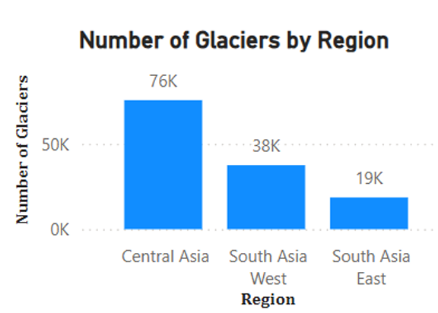
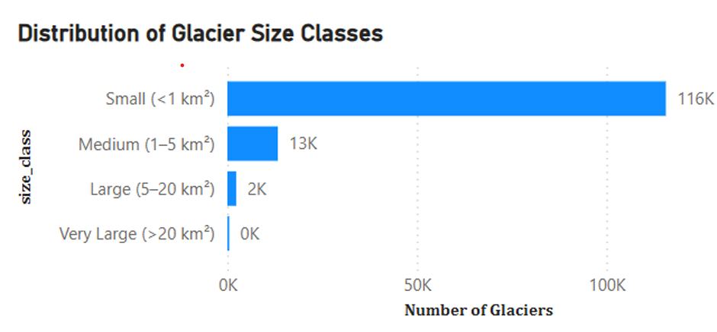
RESULTS
131,762
Total Glaciers
99,468 km
Total Glacier Area
5044m
Avg Median Elevation

Slide 8
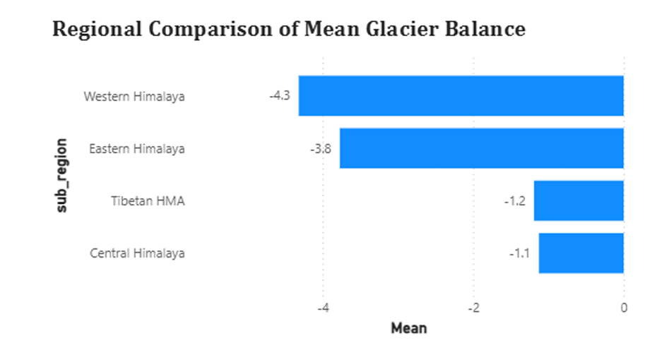
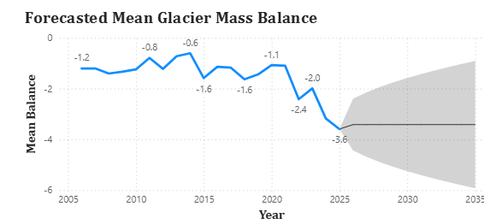
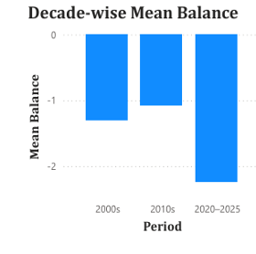
-1.48
Mean Mass Balance (Across all sub-regions)
80.0%
Negative Balance (Glacier mass loss)
2k
Number of Records

Slide 9

Testing & Model Performance
For, Linear Regression, the MAE score is 0.8725, RMSE score is 1.072 and R-square is 0.6133. It explains 61.3 percent of variance. It misses non-linear patterns in glacier climate relationships.
Random Forest Regression, the MAE score is 0.55,RMSE score is 0.7985 and R-square is 0.7903. As, it explains 79 percent of variance. Regard as best model. It captures non-linear interactions between year, elevation, location & sub-region.

Slide 10
Discussion
RGI inventory analysis established a baseline understanding of glacier area across High Mountain Asia. But , full tracking would require satellite derived datasets
Regional variation is not uniform. Western Himalaya(-4.3) and Eastern Himalaya(-3.8) has more negative balance than Central Himalaya(-1.1) and Tibetan HMA(-1.2)
Decade-wise analysis shows that 2020-2025 was the most negative period. Mean balance decreases from -1.1(2020) to -3.6(2025), indicating huge mass loss in recent years
Western and Eastern Himalaya showed the strongest negative mean balance values and can be interpreted as higher mass-loss severity regions.

Slide 11
CONCLUSIONS & RECOMMENDATIONS
Himalayan glaciers are undergoing continuous mass loss
Glacier loss is accelerating in recent years
Western and Eastern Himalayas represent the highest-risk regions
Random Forest achieved the highest predictive performance, demonstrating the value of machine learning for glacier mass-balance forecasting.
Future Recommendations
Integrate climate variables such as temperature, precipitation and snowfall.
Use satellite DEM data and remote sensing for annual glacier change monitoring.
Explore ARIMA, XGBoost, & Gradient Boosting for improved forecasting accuracy
Improve regional classification using glacier basin boundaries
Include glacial lake & GLOF data for hazard-risk assessment.

